Slide 1


http://www.comp.nus.edu.sg/~cs2100/
CS2100
Recitation 11
Pipelining
7 April 2025
Aaron Tan

Slide 2
Contents
Sequential Circuit Quizzes
MIPS Pipeline
Pipeline Hazards
QnA
Pipelining Quiz
Selected Past Years’ Exam Questions
AY2020/21 Sem2 Q16
AY2023/24 Sem1 Q16
Additional exercise
Tracing signals and data in a pipeline

Slide 3
quizzes
Sequential Circuits Quiz 1
Sequential Circuits Quiz 2

Slide 4
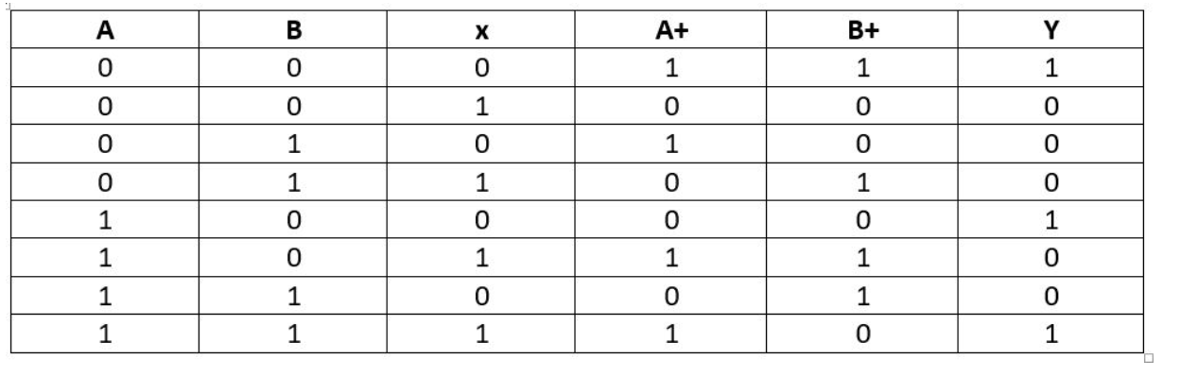
Sequential Circuits Quiz 1
In this quiz we are given the following table:

Slide 5
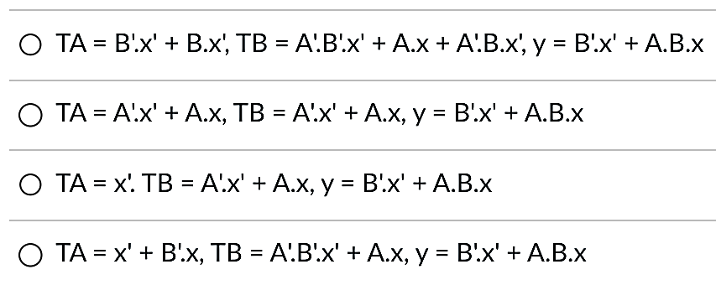
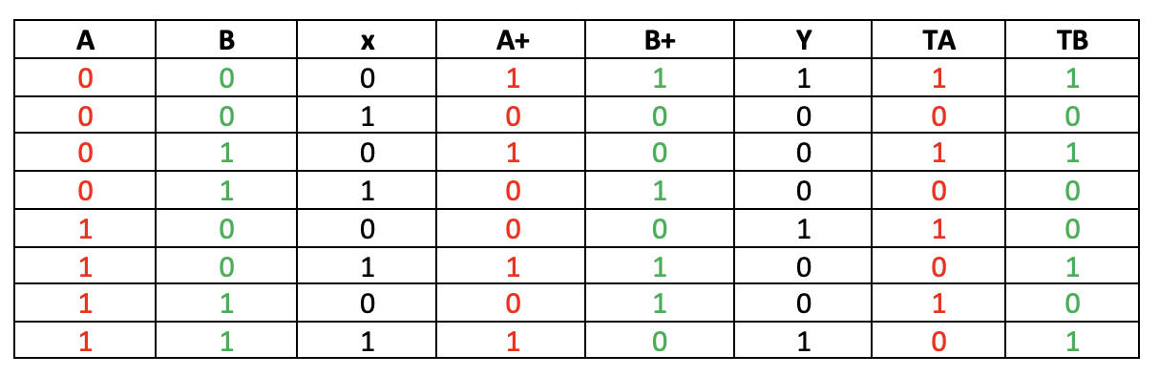
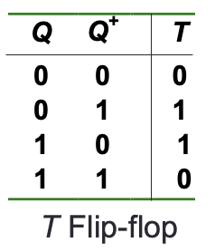
Sequential Circuits Quiz 1 Question 1
Suppose we use T flip-flops (FFs) to implement the sequential circuit. Choose the most simplified FF input equations and sequential circuit output equations from below:
TA
B
1
0
0
1
A
1
0
0
1
x
TB
B
y
B
1
0
0
1
1
0
0
0
A
0
1
1
0
A
1
0
1
0
Augmented State Table:
x
x

Slide 6
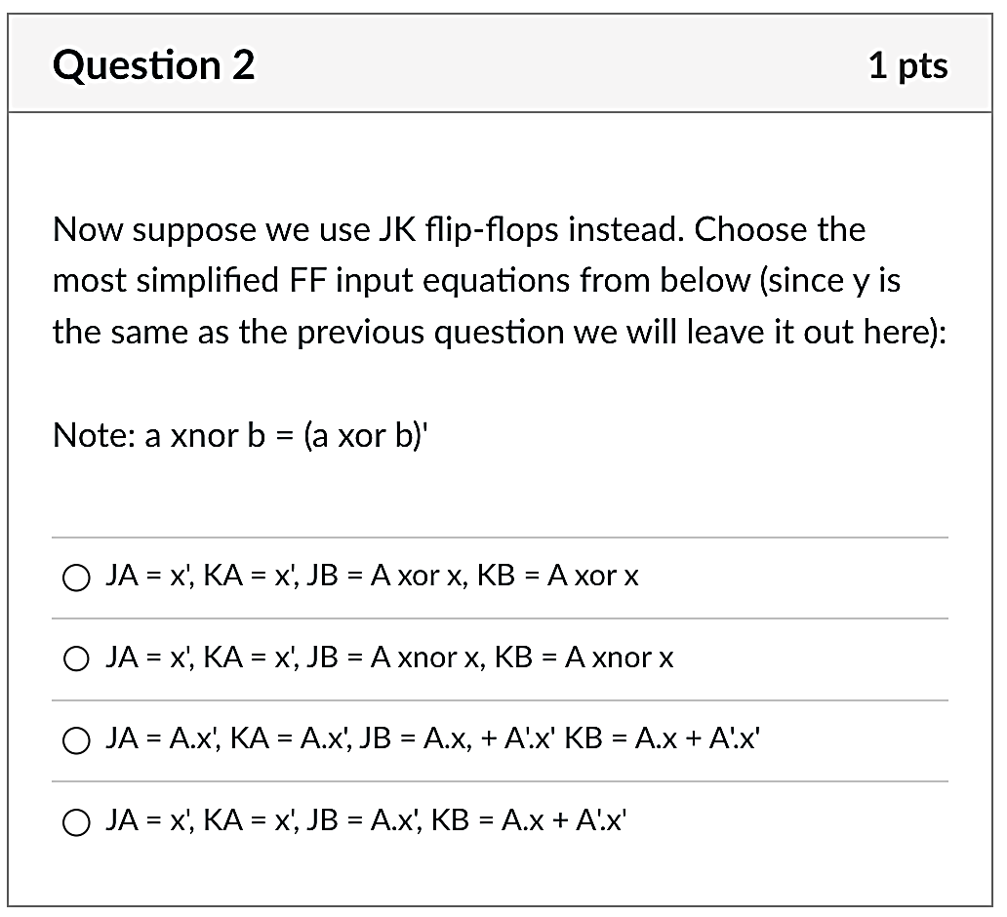
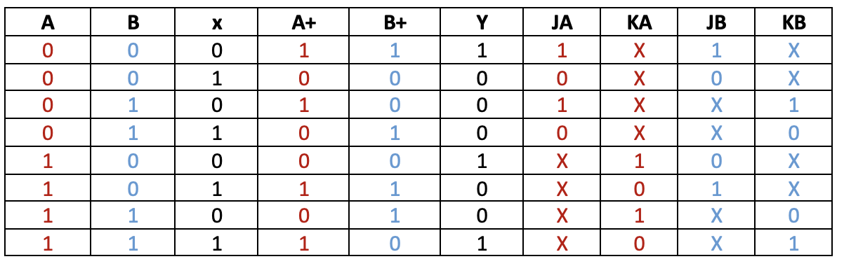
Sequential Circuits Quiz 1 Question 2
Now suppose we use JK flip-flops instead. Choose the most simplified FF input equations from below:
(Note: a XNOR b = (a XOR b)’).
JA
B
KA
B
1
0
0
1
X
X
X
X
A
X
X
X
X
A
1
0
0
1
x
x
JB
B
KB
B
1
0
X
X
X
X
0
1
A
0
1
X
X
A
X
X
1
0
Augmented State Table:
x
x
JK Flip-flop

Slide 7
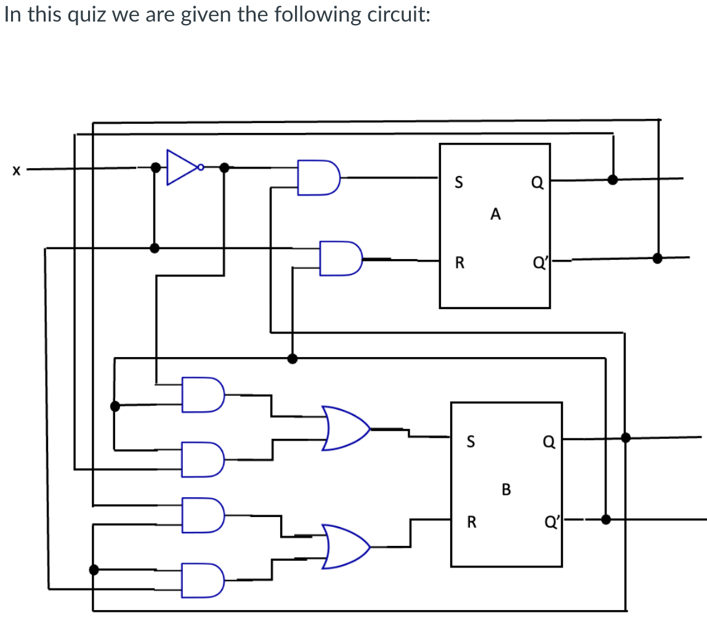
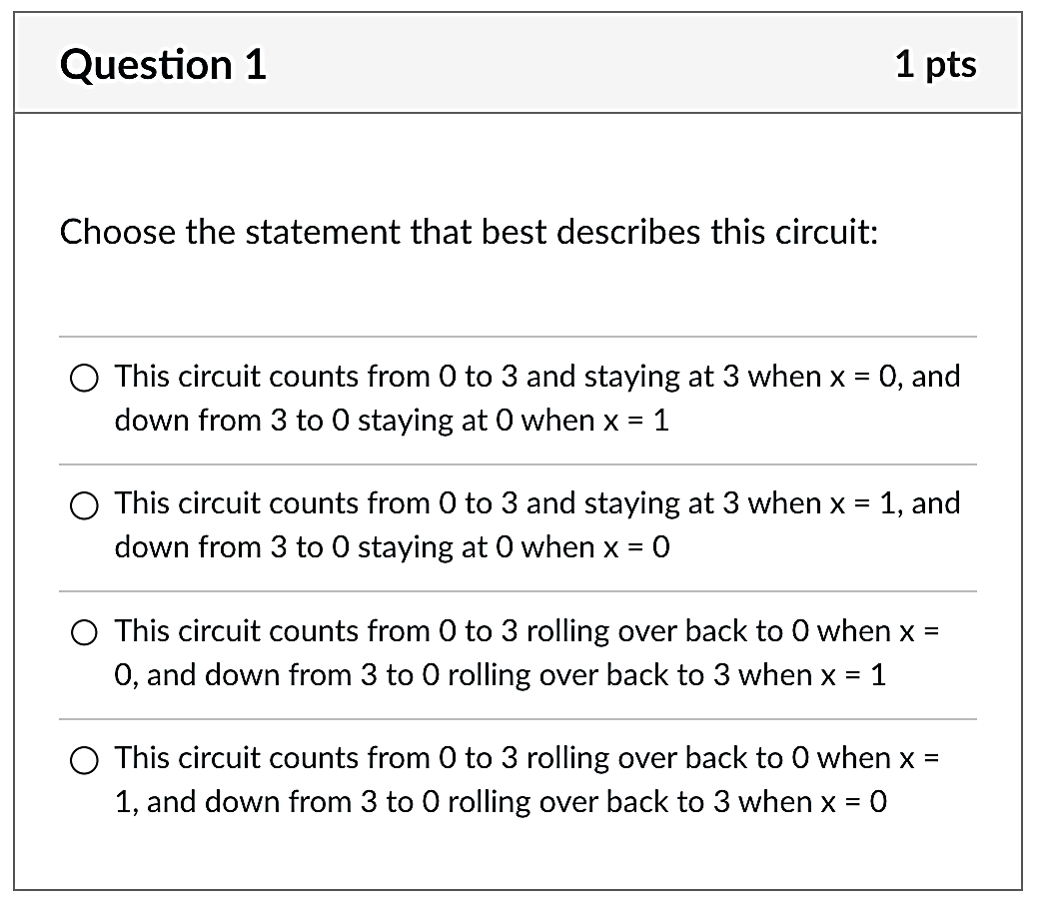
Sequential Circuits Quiz 2
QnA: Can you please go through Sequential Circuits Quiz 2 more thoroughly? I very get confused with it.
In this quiz we are given the following circuit:
Choose the statement that best describes this circuit:

Slide 8
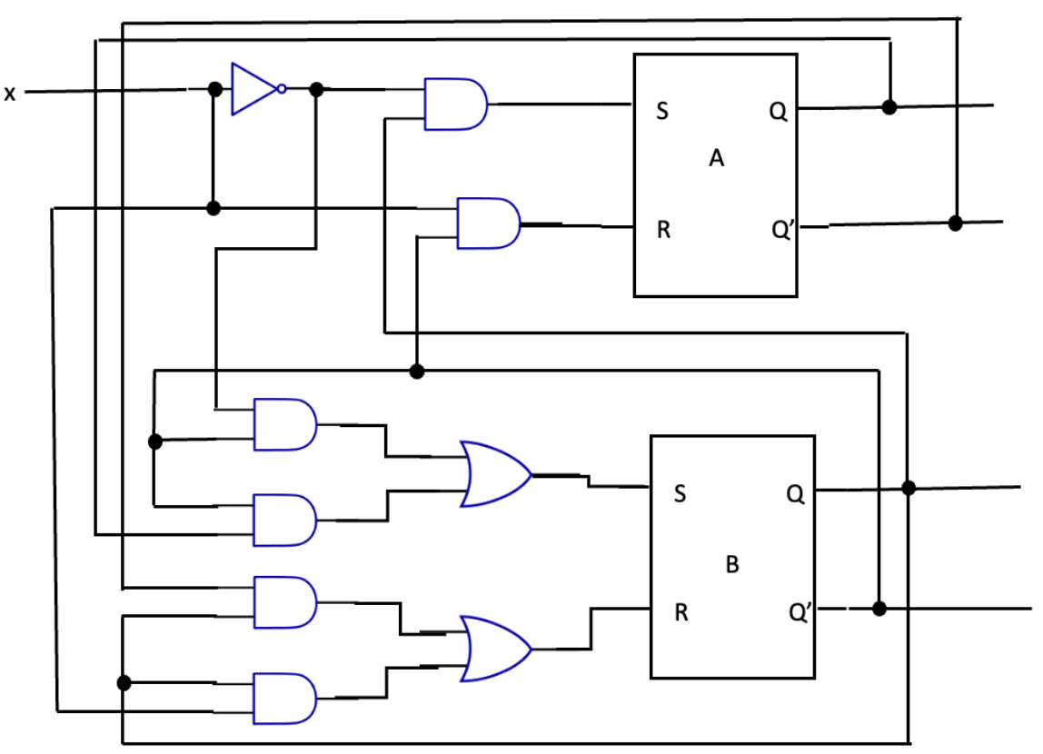
Sequential Circuits Quiz 2 Question 1
x’
B·x’
A
B’·x
A’
B’·x’
B’·x’ + A·B’
A·B’
B
A’·B
A’·B + B·x
B’
B·x

Slide 9
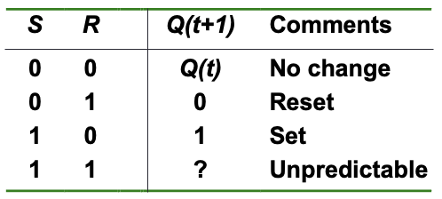
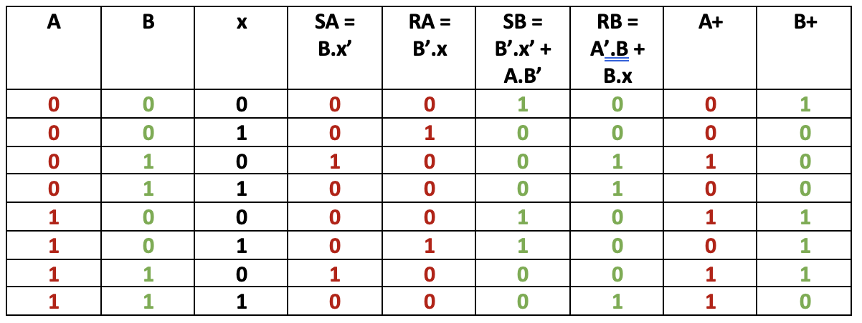
Sequential Circuits Quiz 2 Question 1
State Table
x’
B·x’
A
B’·x
A’
B’·x’
B’·x’ + A·B’
A·B’
B
A’·B
A’·B + B·x
B’
B·x

Slide 10
State Table
State Diagram
1
0
00
01
1
0
1
1
0
11
10
0

Slide 11
Sequential Circuits Quiz 2 Question 1
State Diagram
1
0
Choose the statement that best describes this circuit:
00
01
1
0
1
1
0
11
10
0

Slide 12
MIPS Pipeline

Slide 13
2. MIPS Pipeline Stages
Five Execution Stages
IF: Instruction Fetch
ID: Instruction Decode and Register Read
EX: Execute an operation or calculate an address
MEM: Access an operand in data memory
WB: Write back the result into a register
Time
IF
ID
EX
MEM
WB
IF
ID
EX
MEM
WB
IF
ID
EX
MEM
WB
IF
ID
EX
MEM
WB
Program Flow
(Instructions)
IF
ID
EX
MEM
WB
Several instructions are in the pipeline simultaneously!
IF
ID
EX
MEM
WB

Slide 14
3. MIPS Pipeline: Datapath
Single-cycle implementation:
One cycle per instruction.
Update all state elements (PC, register file, data memory) within a clock cycle.
Pipelined implementation:
One cycle per pipeline stage.
Data required for each stage needs to be stored separately (why?)
Data used by subsequent instructions:
Store in programmer-visible state elements: PC, register file and memory
Data used by same instruction in later pipeline stages:
Additional registers in datapath called pipeline registers
IF/ID: register between IF and ID
ID/EX: register between ID and EX
EX/MEM: register between EX and MEM
MEM/WB: register between MEM and WB
Why no register at the end of WB stage?

Slide 15
3. MIPS Pipeline: Datapath
Coloured rectangles are pipeline registers
Why no pipeline register at the end of WB stage?

Slide 16
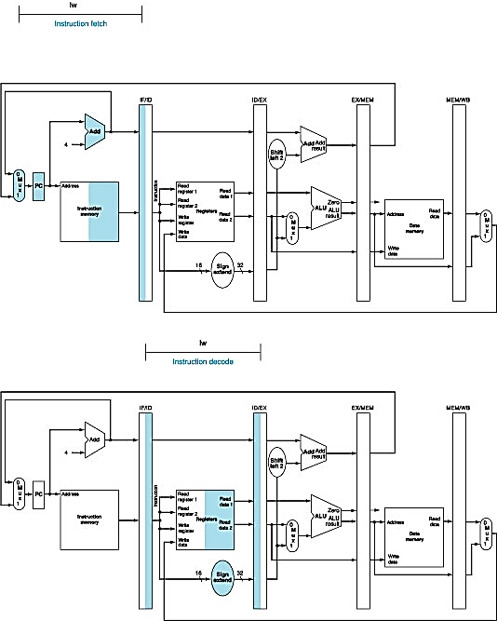
3. Pipeline Datapath: IF Stage
At the end of a cycle, IF/ID receives (stores):
Instruction read from InstructionMemory[ PC ]
PC + 4
PC + 4
Also connected to one of the MUX's inputs (another coming later)

Slide 17
3. Pipeline Datapath: ID Stage
At the beginning of a cycle IF/ID register supplies: | At the end of a cycle ID/EX receives:
Register numbers for reading two registers 16-bit offset to be sign-extended to 32-bit PC + 4 | Data values read from register file 32-bit immediate value PC + 4

Slide 18
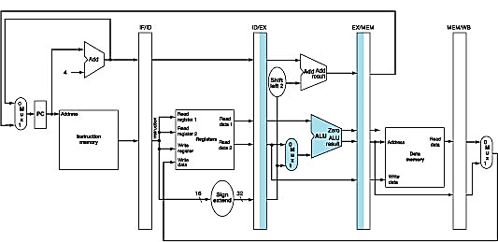
3. Pipeline Datapath: EX Stage
At the beginning of a cycle ID/EX register supplies: | At the end of a cycle EX/MEM receives:
Data values read from register file 32-bit immediate value PC + 4 | (PC + 4) + (Immediate x 4) ALU result isZero? signal Data Read 2 from register file

Slide 19
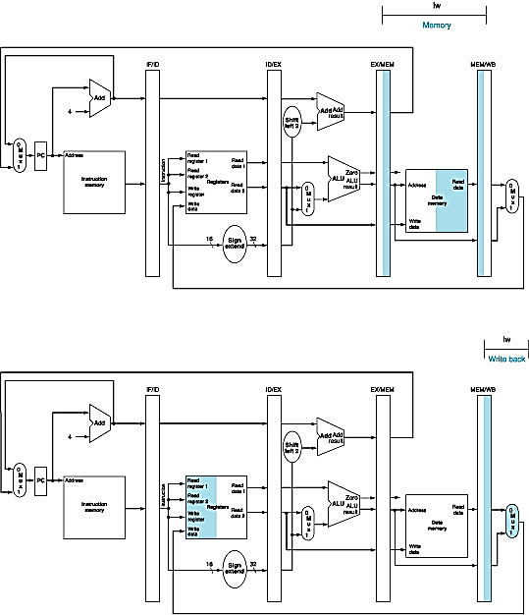
3. Pipeline Datapath: MEM Stage
At the beginning of a cycle EX/MEM register supplies: | At the end of a cycle MEM/WB receives:
(PC + 4) + (Immediate x 4) ALU result isZero? signal Data Read 2 from register file | ALU result Memory read data

Slide 20
3. Pipeline Datapath: WB Stage
At the beginning of a cycle MEM/WB register supplies: | At the end of a cycle
ALU result Memory read data | Result is written back to register file (if applicable) There is a bug here…….

Slide 21
3. Corrected Datapath (1/2)
Observe the “Write register” number
Supplied by the IF/ID pipeline register
It is NOT the correct write register for the instruction now in WB stage!
Solution:
Pass “Write register” number from ID/EX through EX/MEM to MEM/WB pipeline register for use in WB stage
i.e. let the "Write register" number follows the instruction through the pipeline until it is needed in WB stage

Slide 22
3. Corrected Datapath (2/2)

Slide 23
4. Pipeline Control: Main Idea
Same control signals as single-cycle datapath
Difference: Each control signal belongs to a particular pipeline stage

Slide 24
4. Pipeline Control: Grouping
Group control signals according to pipeline stage
 | RegDst | ALUSrc | MemToReg | Reg Write | Mem Read | Mem Write | Branch | ALUop
 |  |  |  |  |  |  |  | op1 | op0
R-type | 1 | 0 | 0 | 1 | 0 | 0 | 0 | 1 | 0
lw | 0 | 1 | 1 | 1 | 1 | 0 | 0 | 0 | 0
sw | X | 1 | X | 0 | 0 | 1 | 0 | 0 | 0
beq | X | 0 | X | 0 | 0 | 0 | 1 | 0 | 1
 | EX Stage |  |  |  | MEM Stage |  |  | WB Stage
 | RegDst | ALUSrc | ALUop |  | Mem Read | Mem Write | Branch | MemToReg | Reg Write
 |  |  | op1 | op0
R-type | 1 | 0 | 1 | 0 | 0 | 0 | 0 | 0 | 1
lw | 0 | 1 | 0 | 0 | 1 | 0 | 0 | 1 | 1
sw | X | 1 | 0 | 0 | 0 | 1 | 0 | X | 0
beq | X | 0 | 0 | 1 | 0 | 0 | 1 | X | 0

Slide 25
4. Pipeline Control: Implementation
Signal used in EX stage and onwards
Signal generated in ID stage
Signal propagated along until utilized

Slide 26
4. Pipeline Control: Datapath and Control

Slide 27
Ideal Pipeline (i.e., No Hazards)
 |  |  | F | D | E | M | W
 |  |  |  | F | D | E | M | W
 |  |  |  |  | F | D | E | M | W
 |  |  |  |  |  | F | D | E | M | W
 |  |  |  |  |  |  | F | D | E | M | W
 |  |  |  |  |  |  |  | F | D | E | M | W
 |  |  |  |  |  |  |  |  | F | D | E | M | W
 |  |  |  |  |  |  |  |  |  | F | D | E | M | W
 | F | D | E | M | W
 |  | F | D | E | M | W
 | 1 | 2 | 3 | 4 | 5 | 6 | 7 | 8 | 9 | 10 | 11 | 12 | 13 | 14
Instr-1
Instr-2
Instr-3
Instr-4
Instr-5
Instr-6
Instr-7
Instr-8
Instr-9
Instr-10
Number of cycles required = 14 cycles
I = No. of instructions.
N = No. of pipeline stages.
No. of cycles = I + (N – 1).

Slide 28
Pipeline Hazards

Slide 29
Pipeline Hazards
3 types of pipeline hazards
Structural hazards
Data hazards
Control hazards

Slide 30
2. Structural Hazard: Memory
Solution: Split memory into Data and Instruction memory
Time (clock cycles)
Load uses Data Memory
Load
Mem
Reg
ALU
Mem
Reg
Inst1
Mem
Reg
ALU
Mem
Reg
Instruction Order
Inst2
Mem
Reg
ALU
Mem
Reg
Inst3
Mem
Reg
ALU
Mem
Reg
Inst3 uses Instr. Memory

Slide 31
2. Structural Hazard: Register File
Recall that registers are very fast memory.
Solution: Split cycle into half; first half for writing into a register; second half for reading from a register.
Time (clock cycles)
Inst0 writes into the register during the first half of the cycle.
Inst0
Mem
Reg
ALU
Mem
Reg
Inst1
Mem
Reg
ALU
Mem
Reg
Instruction Order
Inst2
Mem
Reg
ALU
Mem
Reg
Inst3
Mem
Reg
ALU
Mem
Reg
Inst3 reads from the register during the second half of the cycle.

Slide 32
4. RAW Data Hazards
Value from prior instruction is needed before write back
T
i
m
e
(
i
n
c
l
o
c
k
c
y
c
l
e
s
)
V
a
l
u
e
o
f
C
C
1
C
C
2
C
C
3
C
C
4
C
C
5
C
C
6
C
C
7
C
C
8
C
C
9
r
e
g
i
s
t
e
r
$
2
:
1
0
1
0
1
0
1
0
1
0
/
–
2
0
–
2
0
–
2
0
–
2
0
–
2
0
s
u
b
$
2
,
$
1
,
$
3
I
M
R
e
g
D
M
R
e
g
Data
dependency
No problem
a
n
d
$
1
2
,
$
2
,
$
5
I
M
R
e
g
D
M
R
e
g
o
r
$
1
3
,
$
6
,
$
2
I
M
R
e
g
D
M
R
e
g
a
d
d
$
1
4
,
$
2
,
$
2
I
M
R
e
g
D
M
R
e
g
s
w
$
1
5
,
1
0
0
(
$
2
)
I
M
R
e
g
D
M
R
e
g

Slide 33
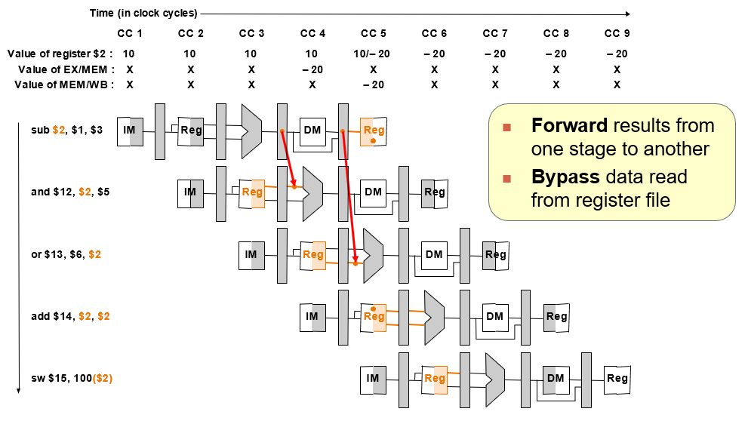
Data Hazards: Forwarding technique (1/2)

Slide 34
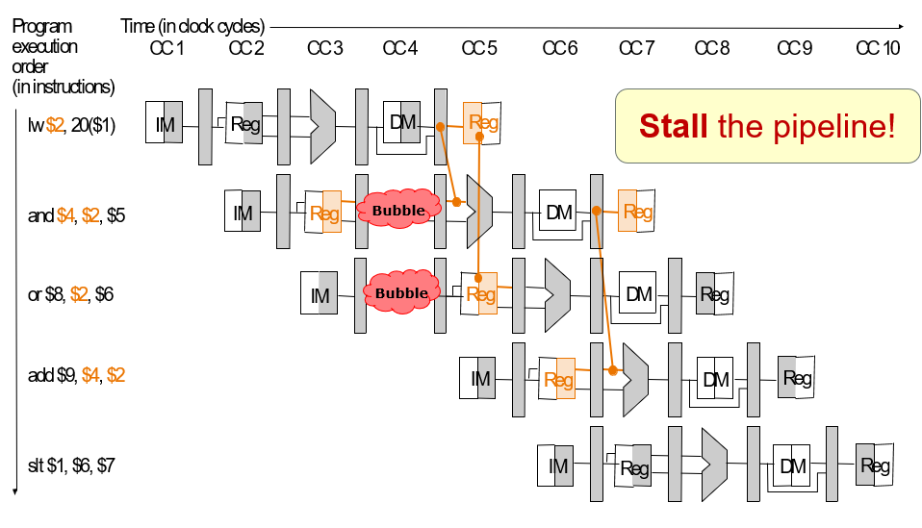
Data Hazards: Forwarding technique (2/2)
Forwarding removes all delay, except for lw (why?)
With forwarding, there is still 1 cycle of delay for the instruction after lw.

Slide 35
5. Control Dependency: Why?
Decision is made in MEM stage:
Too late!

Slide 36
5. Control Dependency: Example
P
r
o
g
r
a
m
T
i
m
e
(
i
n
c
l
o
c
k
c
y
c
l
e
s
)
e
x
e
c
u
t
i
o
n
C
C
1
C
C
2
C
C
3
C
C
4
C
C
5
C
C
6
C
C
7
C
C
8
C
C
9
o
r
d
e
r
Wrong
Execution!
(
i
n
i
n
s
t
r
u
c
t
i
o
n
s
)
4
0
b
e
q
$
1
,
$
3
,
7
I
M
R
e
g
D
M
R
e
g
4
4
a
n
d
$
1
2
,
$
2
,
$
5
I
M
R
e
g
D
M
R
e
g
4
8
o
r
$
1
3
,
$
6
,
$
2
I
M
R
e
g
D
M
R
e
g
5
2
a
d
d
$
1
4
,
$
2
,
$
2
I
M
R
e
g
D
M
R
e
g
7
2
l
w
$
4
,
5
0
(
$
7
)
I
M
R
e
g
D
M
R
e
g

Slide 37
6. Control Hazards: Stall Pipeline?
P
r
o
g
r
a
m
T
i
m
e
(
i
n
c
l
o
c
k
c
y
c
l
e
s
)
e
x
e
c
u
t
i
o
n
C
C
1
C
C
2
C
C
3
C
C
4
C
C
5
C
C
6
C
C
7
C
C
8
C
C
9
o
r
d
e
r
(
i
n
i
n
s
t
r
u
c
t
i
o
n
s
)
4
0
b
e
q
$
1
,
$
3
,
7
I
M
R
e
g
D
M
R
e
g
Bubble
Bubble
Bubble
Bubble
Bubble
Bubble
Bubble
Bubble
Bubble
Bubble
Bubble
Bubble
Bubble
Bubble
Bubble
7
2
l
w
$
4
,
5
0
(
$
7
)
I
M
R
e
g
D
M
R
e
g
Wait until the branch outcome is known and then fetch the correct instructions
➔ Introduces 3 clock cycles delay

Slide 38
Control Hazards
Techniques to reduce stalls:
Early Branching resolution
Move branch decision calculation to earlier pipeline stage
Branch Prediction
Guess the outcome of the branch
Delayed Branching
Do something useful while waiting for the outcome

Slide 39
Control Hazards: Early Branching
Branch resolution made at stage 2 (ID stage)
Branch target
address calculation
PC + 4
Target address
Shift
left 2
Add
QnA:
Q2: Why can’t the next instruction be fetched right after the branch instruction’s ID stage in early branching? Isn’t the branch target address calculated in the EX stage?
4
ALUcontrol
Read
register 1
Read
data 1
Read
register 2
To branch
Control logic
Instruction
ALU
Zero
Write
register
Register File
ALU
result
Write
data
Read
data 2
RegWrite
Sign
extend
Register Comparison
16
32

Slide 40
6.1 Reduce Stalls: Early Branch (3/3)
P
r
o
g
r
a
m
T
i
m
e
(
i
n
c
l
o
c
k
c
y
c
l
e
s
)
e
x
e
c
u
t
i
o
n
C
C
1
C
C
2
C
C
3
C
C
4
C
C
5
C
C
6
C
C
7
C
C
8
C
C
9
o
r
d
e
r
(
i
n
i
n
s
t
r
u
c
t
i
o
n
s
)
4
0
b
e
q
$
1
,
$
3
,
7
I
M
R
e
g
D
M
R
e
g
Bubble
Bubble
Bubble
Bubble
Bubble
7
2
l
w
$
4
,
5
0
(
$
7
)
I
M
R
e
g
D
M
R
e
g
Wait until the branch decision is known:
Then fetch the correct instruction
Reduced from 3 to 1 clock cycle delay

Slide 41
6.1 Early Branch: Problems (1/3)
You solved one problem, but introduced another problem!
However, if the register(s) involved in the comparison is produced by preceding instruction:
Further stall is still needed!
T
i
m
e
(
i
n
c
l
o
c
k
c
y
c
l
e
s
)
P
r
o
g
r
a
m
C
C
1
C
C
2
C
C
3
C
C
4
C
C
5
C
C
6
C
C
7
C
C
8
C
C
9
e
x
e
c
u
t
i
o
n
o
r
d
e
r
(
i
n
i
n
s
t
r
u
c
t
i
o
n
s
)
$s0 is needed before it is produced!
add $s0, $s1, $s2
I
M
R
e
g
D
M
R
e
g
beq $s0, $s3, Exit
I
M
R
e
g
D
M
R
e
g
Bubble
I
M
R
e
g
D
M
R
e
g

Slide 42
6.1 Early Branch: Problems (2/3)
Solution:
Add forwarding path from ALU to ID stage
One clock cycle delay is still needed
T
i
m
e
(
i
n
c
l
o
c
k
c
y
c
l
e
s
)
P
r
o
g
r
a
m
C
C
1
C
C
2
C
C
3
C
C
4
C
C
5
C
C
6
C
C
7
C
C
8
C
C
9
e
x
e
c
u
t
i
o
n
o
r
d
e
r
(
i
n
i
n
s
t
r
u
c
t
i
o
n
s
)
add $s0, $s1, $s2
I
M
R
e
g
D
M
R
e
g
beq $s0, $s3, Exit
I
M
Bubble
R
e
g
D
M
R
e
g
Bubble
I
M
R
e
g
D
M
R
e
g

Slide 43
6.1 Early Branch: Problems (3/3)
Problem is worse with load followed by branch
Solution:
MEM to ID forwarding and 2 more stall cycles!
In this case, we ended up with 3 total stall cycles ➔ no improvement!
T
i
m
e
(
i
n
c
l
o
c
k
c
y
c
l
e
s
)
P
r
o
g
r
a
m
C
C
1
C
C
2
C
C
3
C
C
4
C
C
5
C
C
6
C
C
7
C
C
8
C
C
9
e
x
e
c
u
t
i
o
n
o
r
d
e
r
ALU ➔ ID forwarding cannot help!
(
i
n
i
n
s
t
r
u
c
t
i
o
n
s
)
lw $s0, 0($s1)
I
M
R
e
g
D
M
R
e
g
beq $s0, $s3, Exit
I
M
Bubble
Bubble
R
e
g
D
M
R
e
g
Bubble
I
M
R
e
g
D
M
R
e
g

Slide 44
6.2 Reduce Stalls: Branch Prediction
There are many branch prediction schemes
We only cover the simplest in this course ☺
Simple prediction:
All branches are assumed to be not taken
Fetch the successor instruction and start pumping it through the pipeline stages
When the actual branch outcome is known:
Not taken: Guessed correctly ➔ No pipeline stall
Taken: Guessed wrongly ➔ Wrong instructions in the pipeline ➔ Flush successor instruction from the pipeline

Slide 45
6.2 Branch Prediction: Correct Prediction
T
i
m
e
(
i
n
c
l
o
c
k
c
y
c
l
e
s
)
P
r
o
g
r
a
m
C
C
1
C
C
2
C
C
3
C
C
4
C
C
5
C
C
6
C
C
7
C
C
8
C
C
9
e
x
e
c
u
t
i
o
n
o
r
d
e
r
(
i
n
i
n
s
t
r
u
c
t
i
o
n
s
)
4
0
b
e
q
$
1
,
$
3
,
7
I
M
R
e
g
D
M
R
e
g
4
4
a
n
d
$
1
2
,
$
2
,
$
5
I
M
R
e
g
D
M
R
e
g
4
8
o
r
$
1
3
,
$
6
,
$
2
I
M
R
e
g
D
M
R
e
g
5
2
a
d
d
$
1
4
,
$
2
,
$
2
Branch is known to be not taken in cycle 3
➔ no stall needed!

Slide 46
6.2 Branch Prediction: Wrong Prediction
T
i
m
e
(
i
n
c
l
o
c
k
c
y
c
l
e
s
)
P
r
o
g
r
a
m
C
C
1
C
C
2
C
C
3
C
C
4
C
C
5
C
C
6
C
C
7
C
C
8
C
C
9
e
x
e
c
u
t
i
o
n
QnA:
Q1: hi prof, can explain why is it only 1 clock cycle delay?
o
r
d
e
r
(
i
n
i
n
s
t
r
u
c
t
i
o
n
s
)
4
0
b
e
q
$
1
,
$
3
,
7
I
M
R
e
g
D
M
R
e
g
4
4
a
n
d
$
1
2
,
$
2
,
$
5
I
M
Bubble
Bubble
Bubble
Bubble
7
2
l
w
$
4
,
5
0
(
$
7
)
I
M
R
e
g
D
M
R
e
g
Branch is known to be taken in cycle 3
"and" instruction should not be executed
➔ Flushed from pipeline

Slide 47
6.3 Reduce Stalls: Delayed Branch
Observation:
Branch outcome takes X number of cycles to be known
X cycles stall
Idea:
Move non-control dependent instructions into the X slots following a branch
Known as the branch-delay slot
These instructions are executed regardless of the branch outcome
In our MIPS processor:
Branch-Delay slot = 1 (with the early branch)

Slide 48
6.3 Delayed Branch: Example
Non-delayed branch
or $8, $9, $10
add $1, $2, $3
sub $4, $5, $6
beq $1, $4, Exit
xor $10, $1, $11
Exit:
Delayed branch
add $1, $2, $3
sub $4, $5, $6
beq $1, $4, Exit
or $8, $9, $10
xor $10, $1, $11
Exit:
The "or" instruction is moved into the delayed slot:
Get executed regardless of the branch outcome
➔ Same behavior as the original code!

Slide 49
6.3 Delayed Branch: Observation
Best case scenario
There is an instruction preceding the branch which can be moved into the delayed slot
Program correctness must be preserved!
Worst case scenario
Such instruction cannot be found
➔ Add a no-op (nop) instruction in the branch-delay slot
Re-ordering instructions is a common method of program optimization
Compiler must be smart enough to do this
Usually can find such an instruction at least 50% of the time

Slide 50
QnA

Slide 51
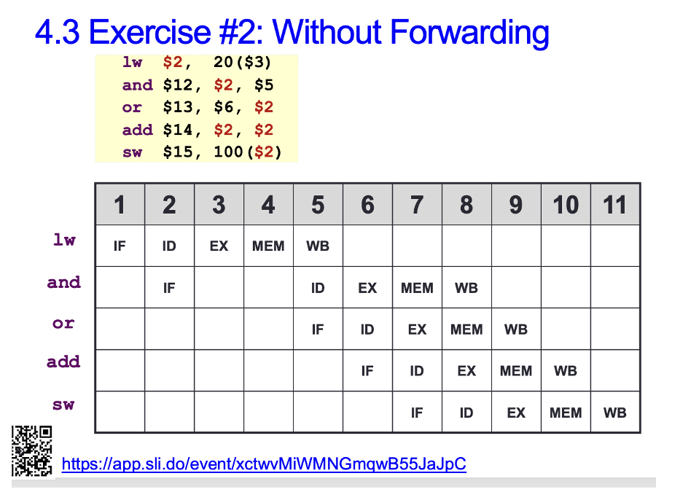
Common question
In Lecture 21 Slide 24, why is the IF stage for the OR instruction in clock cycle 5? Can it not be at clock cycle 3?

Slide 52
QnA Q3
Hi prof, is there any useful observation we can make to calculate the clock cycles efficiently? cus filling in the whole pipeline table does not seem practical under exam conditions.
AY2021/22 Sem1 exam
add $t0, $0, $0 # I1
add $t9, $0, $0 # I2
addi $t1, $a1, 0 # I3
addi $t2, $a2, 0 # I4
sll $t8, $a0, 2 # I5
loop: slt $t3, $t0, $t8 # I6
beq $t3, $0, end # I7
lw $s1, 0($t1) # I8
lw $s2, 0($t2) # I9
slt $t3, $s1, $s2 # I10
bne $t3, $0, else # I11
add $t9, $t9, $s1 # I12
j cont # I13
else: sub $t9, $t9, $s2 # I14
cont: addi $t0, $t0, 4 # I15
addi $t1, $t1, 4 # I16
addi $t2, $t2, 4 # I17
j loop # I18
end:
Refer to the given MIPS code. Assume a 5-stage MIPS pipeline and A[0] > B[0].
(a) How many cycles does this code segment take to complete its execution in the first iteration (I1 to I18) in an ideal pipeline?
Write the total number of additional delay cycles for each of the parts (b) to (d).
(b) Assuming without forwarding and branch decision is made at MEM stage (stage 4). No branch prediction is made.
(c) Assuming with forwarding and branch decision is made at MEM stage (stage 4). No branch prediction is made.
(d) …

Slide 53
QnA Q3
Hi prof, is there any useful observation we can make to calculate the clock cycles efficiently? cus filling in the whole pipeline table does not seem practical under exam conditions.
(b) (c) (d)
add $t0, $0, $0 # I1
add $t9, $0, $0 # I2
addi $t1, $a1, 0 # I3
addi $t2, $a2, 0 # I4
sll $t8, $a0, 2 # I5
loop: slt $t3, $t0, $t8 # I6 +2
beq $t3, $0, end # I7 +2
lw $s1, 0($t1) # I8 +3 +3
lw $s2, 0($t2) # I9
slt $t3, $s1, $s2 # I10 +2 +1
bne $t3, $0, else # I11 +2
add $t9, $t9, $s1 # I12 +3 +3
j cont # I13
else: sub $t9, $t9, $s2 # I14
cont: addi $t0, $t0, 4 # I15 +1 +1
addi $t1, $t1, 4 # I16
addi $t2, $t2, 4 # I17
j loop # I18
end:
Total: +15 +8
AY2021/22 Sem1 exam
Refer to the given MIPS code. Assume a 5-stage MIPS pipeline and A[0] > B[0].
(a) How many cycles does this code segment take to complete its execution in the first iteration (I1 to I18) in an ideal pipeline?
Write the total number of additional delay cycles for each of the parts (b) to (d).
(b) Assuming without forwarding and branch decision is made at MEM stage (stage 4). No branch prediction is made.
(c) Assuming with forwarding and branch decision is made at MEM stage (stage 4). No branch prediction is made.
(d) …

Slide 54
PIPELINING QUIZ

Slide 55
Pipelining Quiz Question 1
Let’s say there are 6 stages in executing an instruction and there are 10 instructions in a program. Each stage takes 1 clock cycle to execute. How many clock cycles are needed to complete the execution of this program in an ideal pipeline?
I = no. of instructions
N = no. of pipeline stages
I + N – 1 = 10 + 6 – 1 = 15 cycles

Slide 56
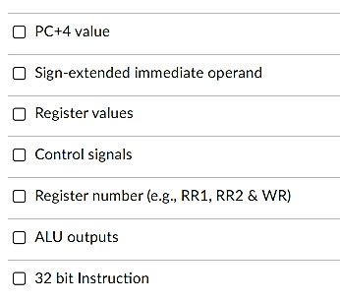
Pipelining Quiz Question 2
Pipeline register can store which of the following?
✓
✓
✓
✓
✓
✓
✓

Slide 57
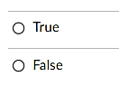
Pipelining Quiz Question 3
Each of the pipeline registers contains multiple registers of size 32 bits?
✓

Slide 58
Pipelining Quiz Question 4
The MIPS processor that we discussed in this course can execute at most 4 instructions simultaneously in an ideal pipeline.
✓

Slide 59
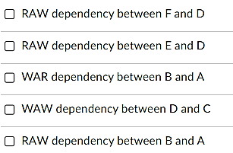
Pipelining Quiz Question 5
Below is a sequence of instructions A to F:
Which of the following are true with respect to RAW, WAR and WAW data dependency?
A. lw $t2, 0($t1)
B. lw $t1, 100($t6)
C. sub $t6, $t1, $t2
D. add $t6, $t2, $t6
E. and $t3, $t6, $0
F. sw $t6, 50($t1)
✓
✓
✓
✓

Slide 60
Pipelining Quiz Question 6
How many cycles are needed to execute this program with and without forwarding?
Without forwarding:
16 cycles
A. lw $t2, 0($t1)
B. lw $t1, 100($t6)
C. sub $t6, $t1, $t2
D. add $t6, $t2, $t6
E. and $t3, $t6, $0
F. sw $t6, 50($t1)
 | 1 | 2 | 3 | 4 | 5 | 6 | 7 | 8 | 9 | 10 | 11 | 12 | 13 | 14 | 15 | 16
lw | F | D | E | M | W
lw
sub
add
and
sw
F D E M W
F D E M W
F D E M W
F D E M W
F D E M W
 | 1 | 2 | 3 | 4 | 5 | 6 | 7 | 8 | 9 | 10 | 11 | 12 | 13 | 14 | 15 | 16
lw | F | D | E | M | W
lw
sub
add
and
sw
With forwarding:
11 cycles
F D E M W
F D E M W
F D E M W
F D E M W
F D E M W

Slide 61
Pipelining Quiz Question 7
How many cycles are needed to execute this program with forwarding, assume branch-taken prediction strategy, branch decision made at MEM, whereas the actual branch in the code is taken.
lw $s2, 0($s1)
bne $s2, $s3, L1
sub $s0, $s4, $s5
L1: add $s0, $s0, $s3
 | 1 | 2 | 3 | 4 | 5 | 6 | 7 | 8 | 9 | 10 | 11 | 12
lw | F | D | E | M | W
bne
add
F D E M W
F D E M W
8 cycles

Slide 62
Pipelining Quiz Question 8
How many cycles are needed to execute this program with forwarding, assume branch-NOT-taken prediction strategy, branch decision made at MEM, whereas the actual branch in the code is taken.
lw $s2, 0($s1)
bne $s2, $s3, L1
sub $s0, $s4, $s5
L1: add $s0, $s0, $s3
 | 1 | 2 | 3 | 4 | 5 | 6 | 7 | 8 | 9 | 10 | 11 | 12
lw | F | D | E | M | W
bne
sub
add
add
F D E M W
F D E M W
F D E M W
F D E M W
11 cycles

Slide 63
Past YEARs’ QUESTIONS
Pipelining
AY2020/21 Sem2 Q16
AY2023/24 Sem1 Q16

Slide 64
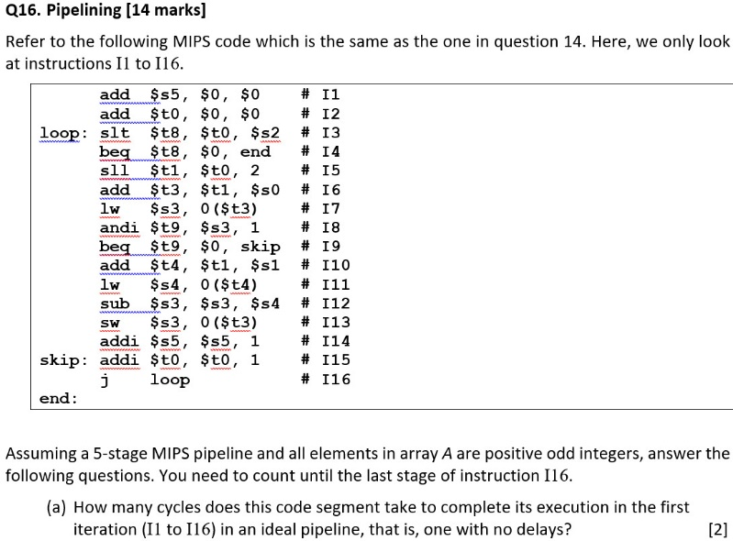
AY2020/21 Sem2 Q16(a)
Answer: 16 + (5 – 1) = 20

Slide 65
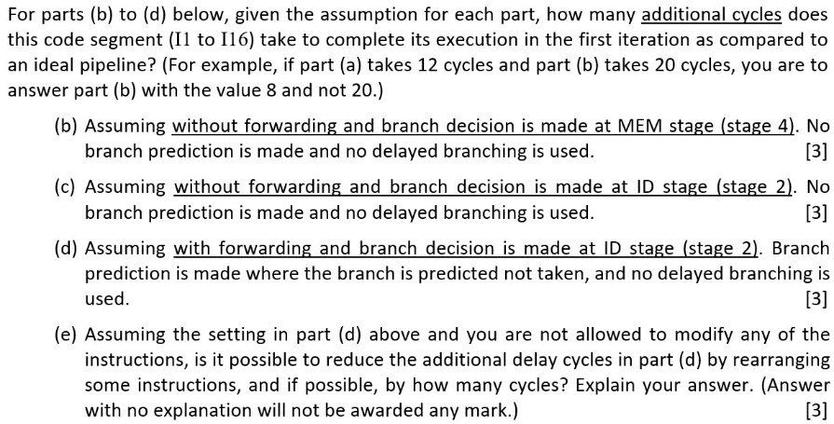
AY2020/21 Sem2 Q16(b)
(b)
+2
+2
+3
+2
+2
+2
+2
+3
+2
+2
+2
24

Slide 66
AY2020/21 Sem2 Q16(c)
(b)
(c)
+2
+2
+2
+2
+3
+1
+2
+2
+2
+2
+2
+2
+2
+2
+3
+1
+2
+2
+2
+2
+2
+2
24
22

Slide 67
AY2020/21 Sem2 Q16(d)
(b)
(c)
(d)
+2
+2
+2
+2
+1
+3
+1
+2
+2
+2
+2
+2
+2
+1
+2
+2
+1
+3
+1
+2
+2
+2
+2
+1
+2
+2
24
22
4

Slide 68
AY2020/21 Sem2 Q16(e)
(b)
(c)
(d)
+2
+2
More than 1 possible answer.
+2
+2
+1
+3
+1
Move I14 (addi $s5, $s5, 1) to between I11 (lw $s4, 0($t4)) and I12 (sub $s3, $s3, $s4) to remove the 1 cycle of delay at I12.
+2
+2
+2
+2
+2
+2
+1
+2
+2
+1
+3
+1
+2
+2
If your answer involves I15, explain where the label “skip” goes to.
+2
+2
+1
+2
+2
24
22
4

Slide 69
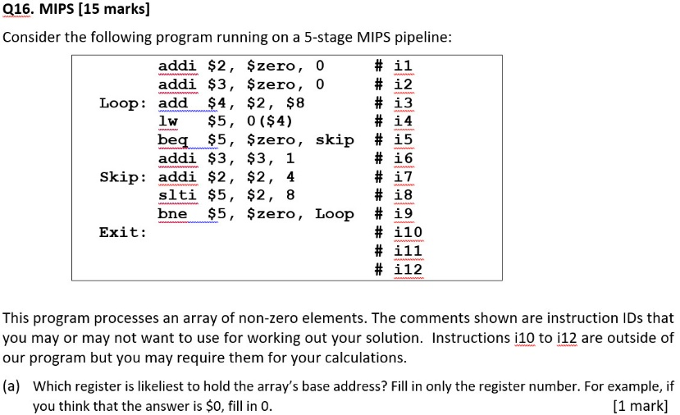
AY2023/24 Sem1 Q16(a)
8 (i.e. $8)

Slide 70
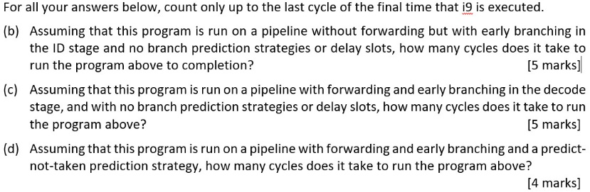
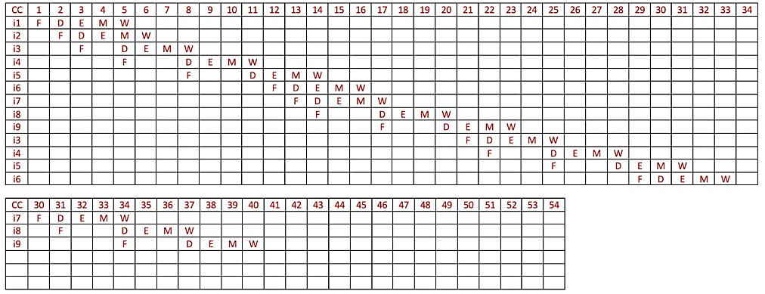
AY2023/24 Sem1 Q16(b)
40 cycles

Slide 71
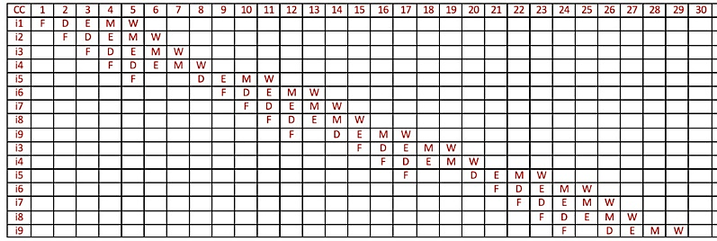
AY2023/24 Sem1 Q16(c)
29 cycles

Slide 72
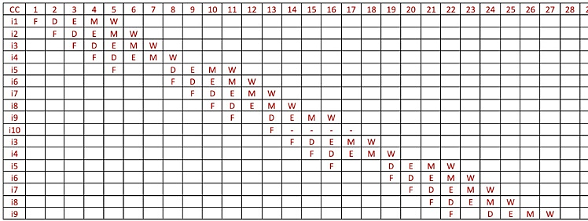
AY2023/24 Sem1 Q16(d)
27 cycles

Slide 73
Additional Exercise: Tracing signals and data
Using Powerpoint animation, give the full details of the signals and data bits (highlighting those lines that are active) of the following code that is executed in a pipelined MIPS. Assume that L is at address 0x00000100 and the beq instruction is at address 0x00001000.
sub $1, $2, $3
lw $6, 4($7)
beq $4, $5, L
Credit: A/P Anandha Gopalan

Slide 74
Q1
PC= 0xFFC
PCSrc
ID/EX
EX/MEM
Control
IF/ID
Add
MEM/WB
Add
Branch
4
RegWrite
Shift
left 2
Instruction
Memory
Read Addr 1
Data
Memory
Register
File
Read
Data 1
Read Addr 2
MemtoReg
PC
Read
Address
ALUSrc
Read
Data
Write Addr
ALU
Address
Read
Data 2
Write Data
Write Data
ALU
cntrl
PC= 0xFF8
Sign
Extend
MemWrite
MemRead
0x00430822
16
32
ALUOp
RegDst
sub $1, $2, $3

Slide 75
Branch = 0
MemRead = 0
MemWrite = 0
Q1
RegDst = 1
ALUOp = 2
ALUSrc = 0
RegWrite = 1
MemtoReg = 0
PC= 0x1000
PCSrc
ID/EX
EX/MEM
Control
IF/ID
Add
MEM/WB
Add
Branch
4
RegWrite
Shift
left 2
2
Instruction
Memory
Read Addr 1
Data
Memory
3
Register
File
Read
Data 1
Read Addr 2
MemtoReg
PC
Read
Address
ALUSrc
Read
Data
Write Addr
ALU
Address
Read
Data 2
Write Data
Write Data
ALU
cntrl
PC= 0xFFC
Sign
Extend
MemWrite
MemRead
0x8CE60004
16
32
ALUOp
RegDst
lw $6, 4($7)
sub $1, $2, $3

Slide 76
Branch = 0
MemRead = 1
MemWrite = 0
Branch = 0
MemRead = 0
MemWrite = 0
Q1
RegDst = 0
ALUOp = 0
ALUSrc = 1
RegWrite = 1
MemtoReg = 1
RegWrite = 1
MemtoReg = 0
PC= 0x1004
PCSrc
ID/EX
EX/MEM
Control
IF/ID
Add
MEM/WB
Add
Branch
4
RegWrite
Shift
left 2
7
Instruction
Memory
Read Addr 1
Data
Memory
X
Register
File
Read
Data 1
0
Read Addr 2
MemtoReg
PC
Read
Address
ALUSrc
Read
Data
Write Addr
ALU
Address
Read
Data 2
Write Data
Write Data
ALU
cntrl
PC= 0x1000
Sign
Extend
2
MemWrite
MemRead
0x1085FC3F
16
32
ALUOp
1
RegDst
beq $4, $5, L
lw $6, 4($7)
sub $1, $2, $3

Slide 77
Branch = 1
MemRead = 0
MemWrite = 0
Branch = 0
MemRead = 1
MemWrite = 0
Q1
RegDst = X
ALUOp = 2
ALUSrc = 0
RegWrite = 0
MemtoReg = X
RegWrite = 1
MemtoReg = 1
PCSrc
ID/EX
EX/MEM
Control
RegWrite = 1
MemtoReg = 0
IF/ID
Add
0
Branch
MEM/WB
4
RegWrite
Shift
left 2
Add
4
Instruction
Memory
Read Addr 1
Data
Memory
5
Register
File
Read
Data 1
1
Read Addr 2
MemtoReg
PC
Read
Address
ALUSrc
Read
Data
Write Addr
ALU
Address
Read
Data 2
Write Data
Write Data
ALU
cntrl
Sign
Extend
0
MemWrite
MemRead
16
32
0
0
ALUOp
0
RegDst
beq $4, $5, L
lw $6, 4($7)
sub $1, $2, $3

Slide 78
Branch = 1
MemRead = 0
MemWrite = 0
Q1
RegWrite = 0
MemtoReg = X
PCSrc
ID/EX
EX/MEM
Control
RegWrite = 1
MemtoReg = 1
IF/ID
Add
0
Branch
MEM/WB
4
RegWrite
1
Shift
left 2
Add
Instruction
Memory
Read Addr 1
Data
Memory
0
Register
File
Read
Data 1
1
Read Addr 2
MemtoReg
PC
Read
Address
ALUSrc
Read
Data
Write Addr
ALU
Address
1
Read
Data 2
Write Data
Write Data
ALU
cntrl
Sign
Extend
0
MemWrite
MemRead
16
32
0
1
ALUOp
sub $1, $2, $3
0
RegDst
beq $4, $5, L
lw $6, 4($7)

Slide 79
Q1
PCSrc
0x100
ID/EX
EX/MEM
Control
RegWrite = 0
MemtoReg = X
IF/ID
Add
1
Branch
MEM/WB
4
RegWrite
1
Shift
left 2
Add
Instruction
Memory
Read Addr 1
Data
Memory
1
Register
File
Read
Data 1
Read Addr 2
MemtoReg
PC
Read
Address
ALUSrc
Read
Data
Write Addr
ALU
Address
6
Read
Data 2
Write Data
Write Data
ALU
cntrl
Sign
Extend
MemWrite
MemRead
16
32
0
0
ALUOp
lw $6, 4($7)
RegDst
beq $4, $5, L

Slide 80
Q1
PCSrc
ID/EX
EX/MEM
Control
IF/ID
Add
MEM/WB
0
Add
Branch
4
RegWrite
Shift
left 2
Instruction
Memory
Read Addr 1
Data
Memory
X
Register
File
Read
Data 1
Read Addr 2
MemtoReg
PC
Read
Address
ALUSrc
Read
Data
Write Addr
ALU
Address
Read
Data 2
Write Data
Write Data
ALU
cntrl
Sign
Extend
MemWrite
MemRead
16
32
ALUOp
beq $4, $5, L
RegDst

Slide 81
Next week – Final recitation!
Cache

Slide 82
End of File

